Slide 1
OpenGL - Debugging tools
Advanced Graphics Programming

Slide 2
OpenGL - Debugging tools
OpenGL programming can be very error prone
Most of the time, a single failing call to OpenGL can cause an entire portion of an application to stop working, with nothing being drawn on the screen.
Examples:
An incorrect parameter was passed to an OpenGL function
We did not send some parameters to the shader properly
We forgot to bind some resource (VAO, program, framebuffer…)
Long list of etcetera

Slide 3
Classic way: glGetError()

Slide 4
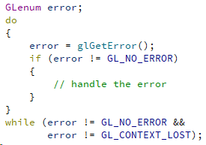
OpenGL - glGetError function
Make sure no errors are being returned by OpenGL:
After every API call
At some points in your application
Errors stack up, so they have to be handled with the function glGetError() using a loop.

Slide 5
OpenGL - glGetError function
For a list of all errors returned by glGetError() you can refer to the following page:
https://www.khronos.org/opengl/wiki/OpenGL_Error

Slide 6
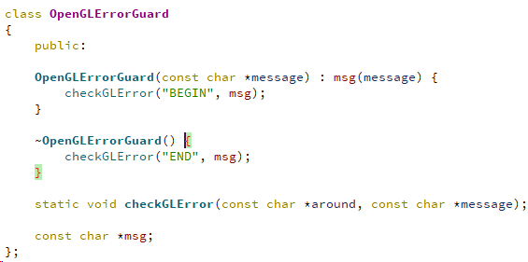
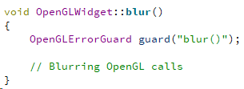
OpenGL - glGetError function
Error guards
Objects to check errors within a scope
Use of constructor and destructor
Usage
Define an object at some point within a scope
The object will check for errors when created and destroyed
glGetError() stuff...

Slide 7
GL_KHR_debug extension

Slide 8
GL_KHR_debug extension
https://www.khronos.org/registry/OpenGL/extensions/KHR/KHR_debug.txt
First available in OpenGL 4.2
Core since 4.3 (no need to check availability :-)
Provides several utilities. Among others, I found these two the most useful:
Installing a custom error callback
Inserting custom debug markers

Slide 9
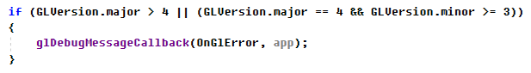
GL_KHR_debug - debug callback
During initialization, we can install a custom error callback this way:
First parameter is our callback function. More info here:
https://www.khronos.org/opengl/wiki/Debug_Output
Second parameter is a custom user pointer, just in case we need access to some of our data

Slide 10
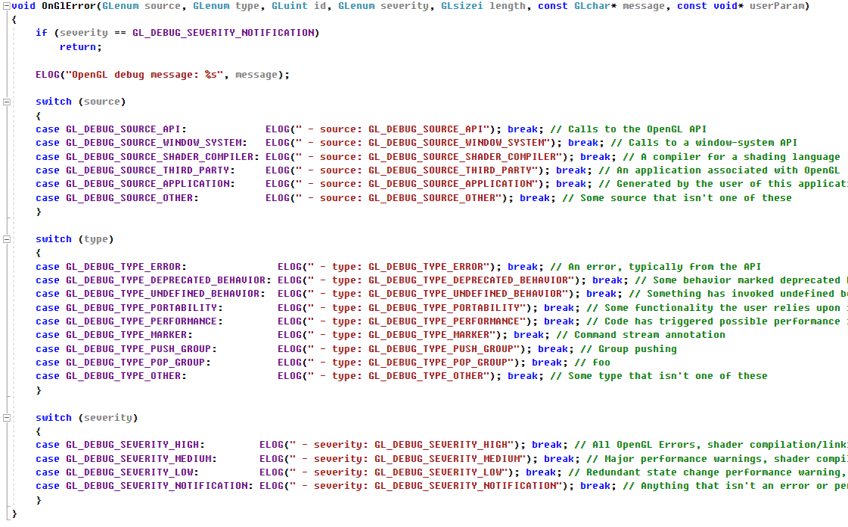
GL_KHR_debug - debug callback

Slide 11
GL_KHR_debug - debug callback
You can put breakpoints in this function!!!

Slide 12

Shader hot reload

Slide 13
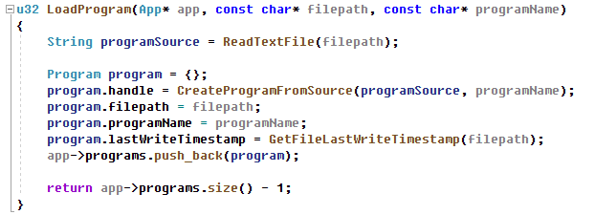
Shader file timestamp
With this timestamp you can later check whether or not the file was modified since it was loaded...

Slide 14
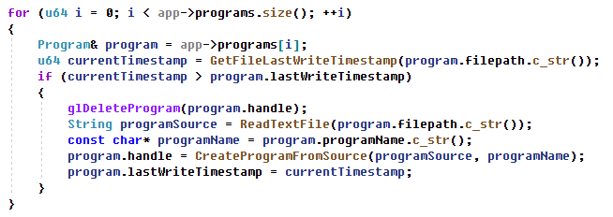
In Update() -> check timestamp / reload

Slide 15

RenderDoc

Slide 16
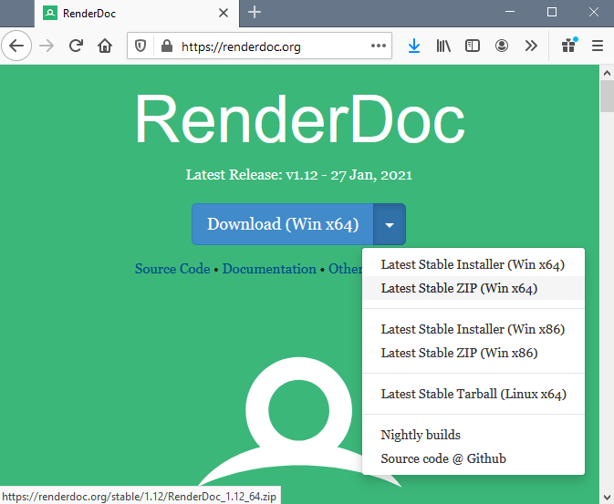
RenderDoc (will save your life ;-)
Be sure to download the appropriate version…
Probably Win x64 (if you are compiling your OpenGL application in for x64)

Slide 17
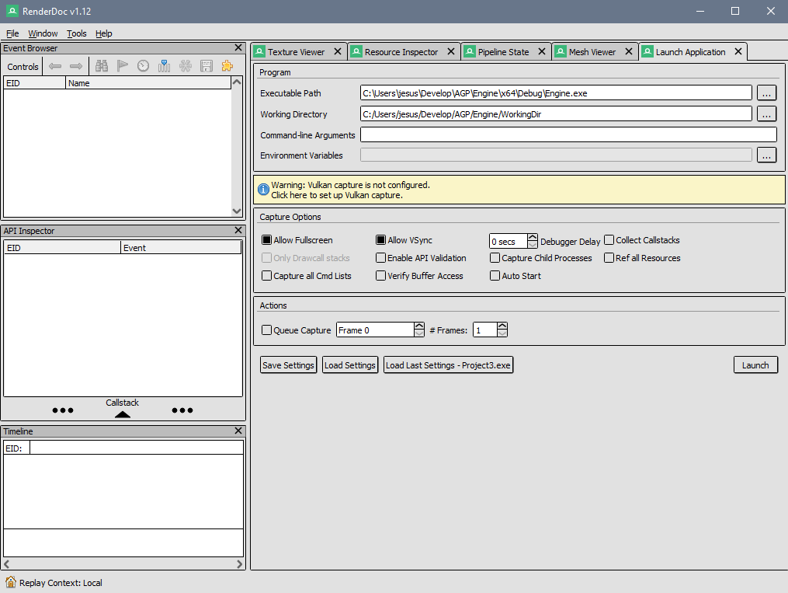
Launch your application
Zoomed view

Slide 18
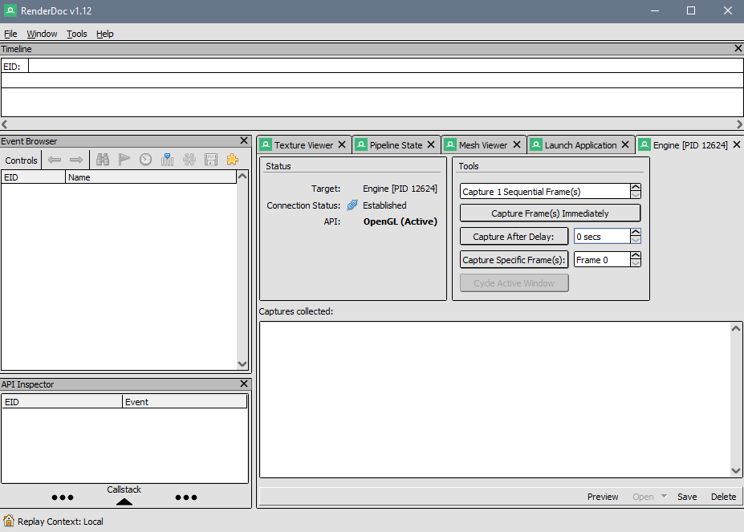
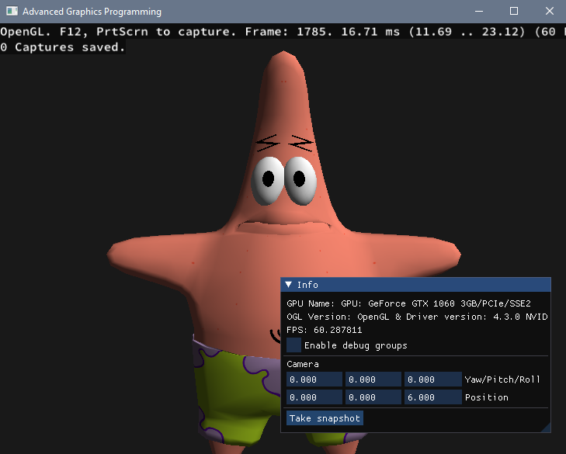
Capture a frame trace

Slide 19
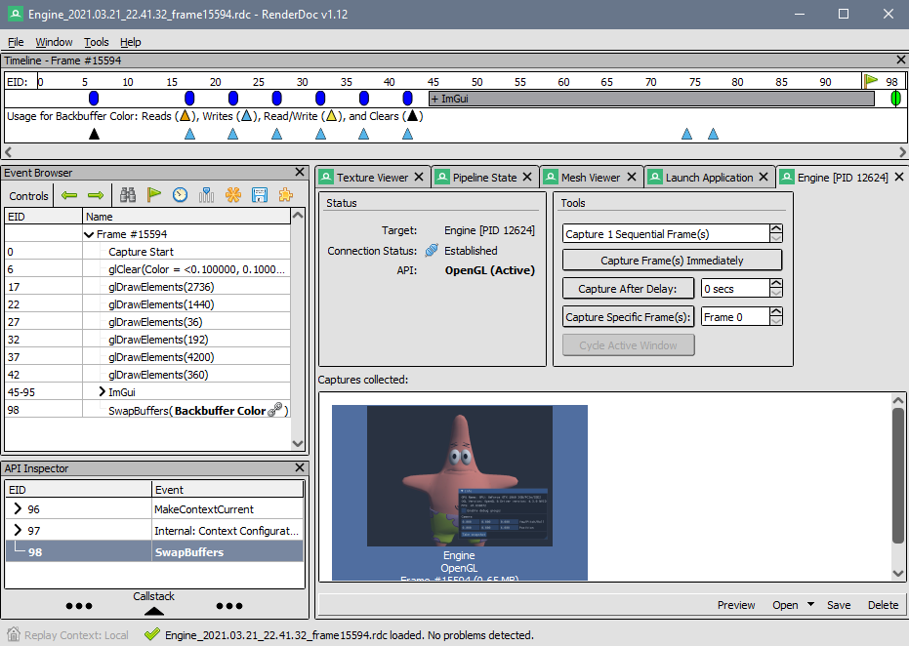
You can see all the OpenGL draw calls
Double click on this capture, and you will see all the draw calls in the event browser

Slide 20
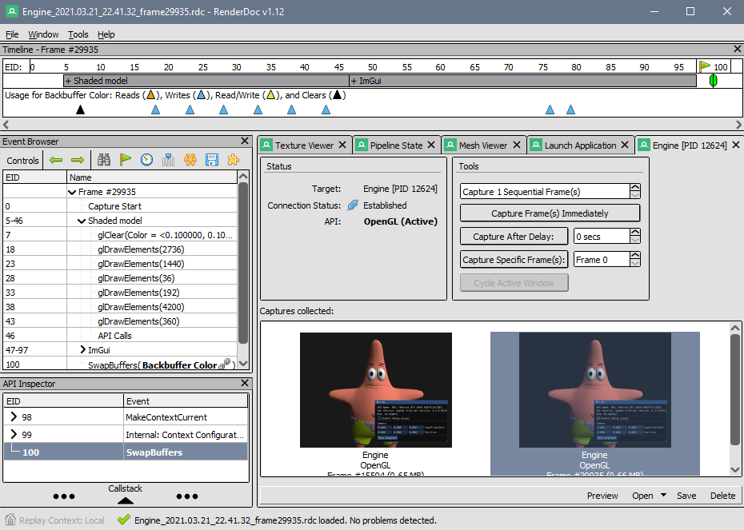

We can create draw call groups… how??
Second capture after enabling debug groups

Slide 21
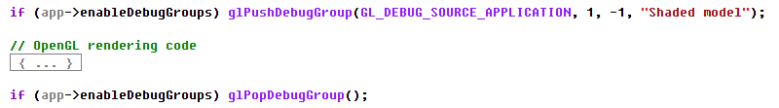
Thanks to glPushDebugGroup / glPopDebugGroup
They belong to GL_KHR_debug extension
You know, Core since OpenGL 4.3
No need for the enableDebugGroups boolean (that was just to make a point)
Between these calls one would change the OpenGL state and submit several draw calls
Even several iterations of changing state -> draw calls

Slide 22
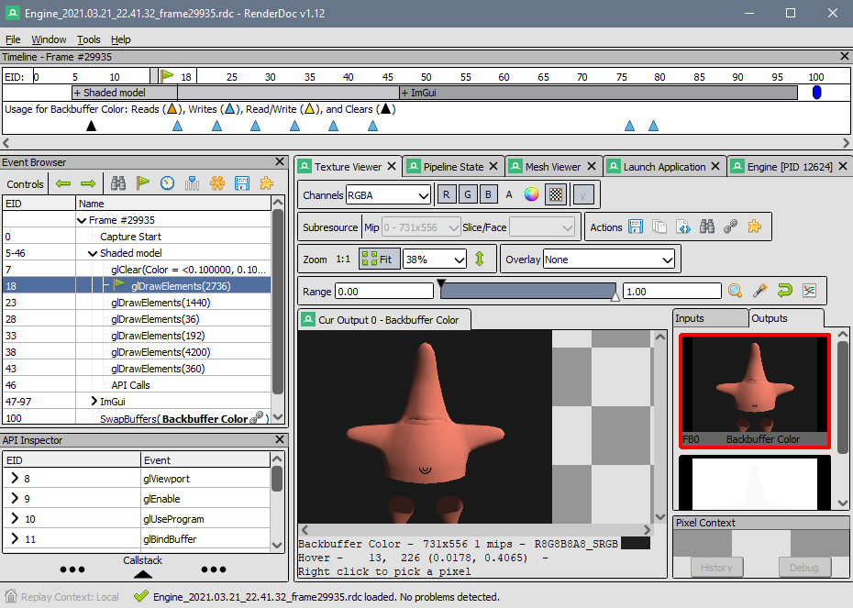
Texture Viewer
Selecting a draw call, we can see what was rendered in the output viewport

Slide 23
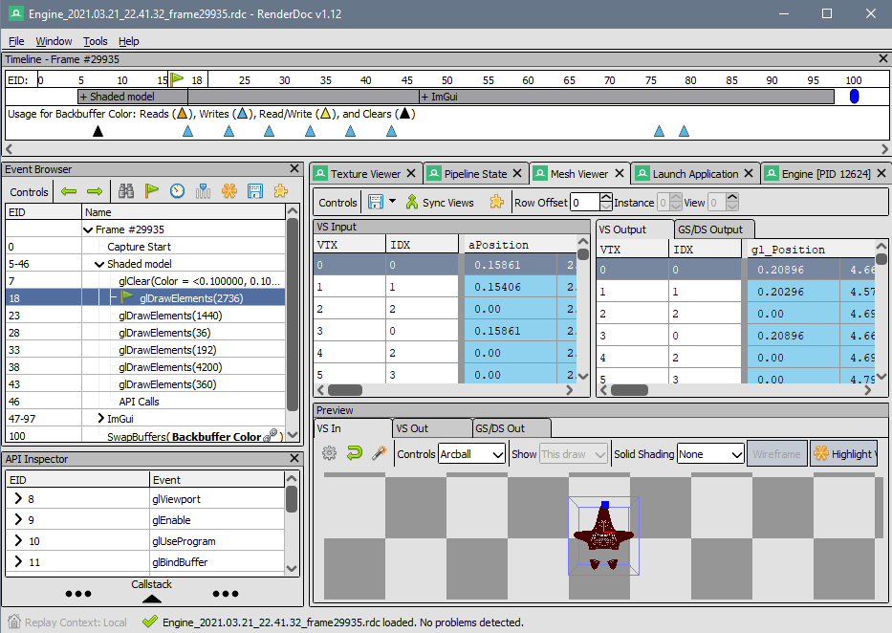
Mesh Viewer
In the Mesh Viewer, we can also see (for a draw call) what the input and the output of the vertex shader is…
Useful to see if you have configured your VBO/EBO/VAOs correctly (input)
Useful to see if your vertex shader transforms are correct (output)

Slide 24
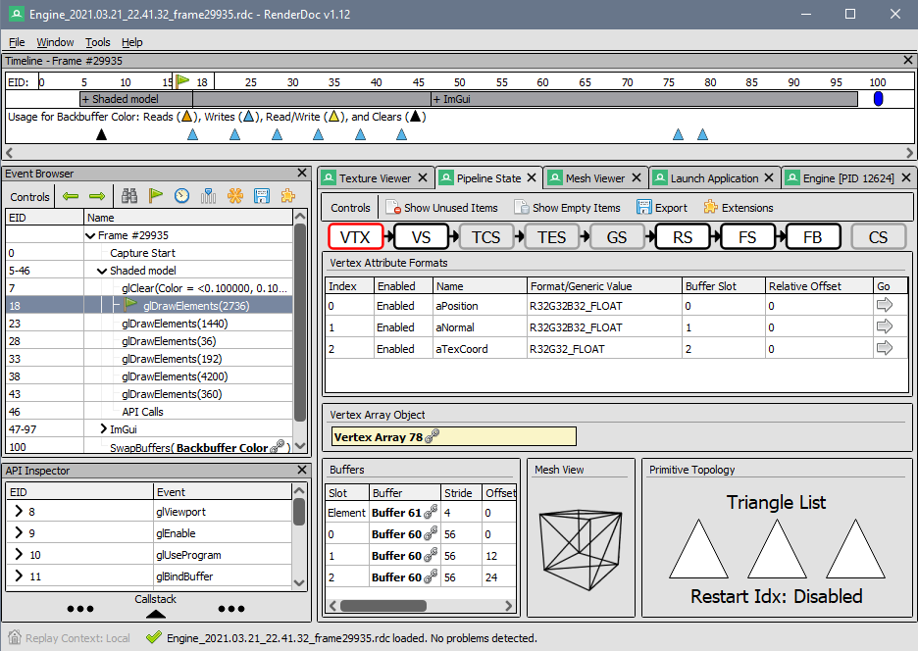
Pipeline state
By clicking on each one of the stages, we can see exactly how they are configured… and detect if something is not the way we intended.
Vertex input buffers
Shader uniform inputs
VS / FS
Buffers and textures
Rasterization state
Backface culling
Fill mode
Framebuffer state
Blending
Depth test

Slide 25

Now a magic trick...

Slide 26
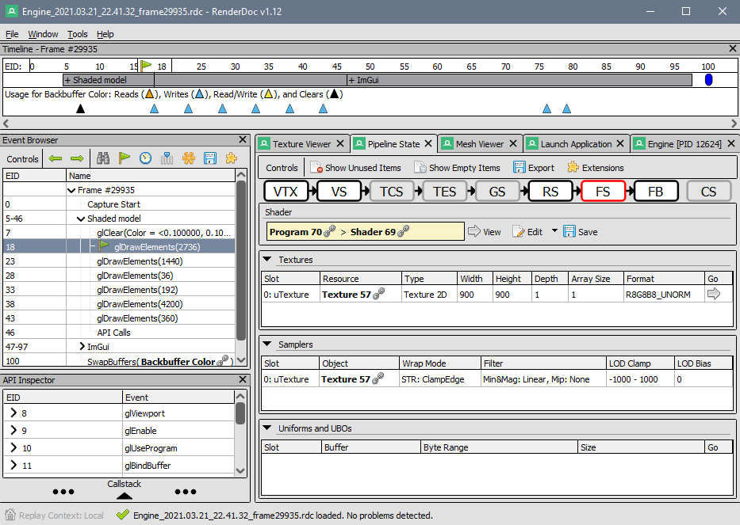

You can edit->apply changes in shaders!!!

Slide 27
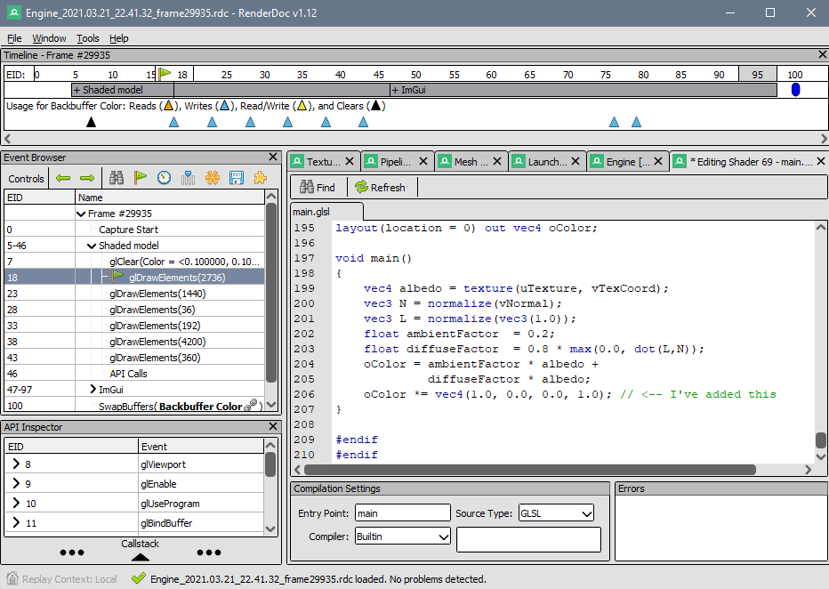

You can edit->apply changes in shaders!!!

Slide 28

Now get your weapons ready...
Here we go OpenGL!!!

